Slide 1
GROUP DECISION SUPPORT SYSTEM

Slide 2
Group Decision Support System
Group Decision Support System (GDSS)
  Contains most of the elements of DSS plus software to provide effective support in group decision-making settings
  Decision making is shared process
  Meeting among groups of managers from different areas.

Slide 3
Group Decision Support System
GDSS is an interactive computer- based system that facilitates solution of semi structured and unstructured problems when made by a group of decision makers by concentrating on the process and procedures during meeting.

Slide 4
Group Decision Support System
Basic objective
GDSS is to support the process of arriving at a decision.

Slide 5
Group Decision Support System
Two type of GDSS:-
A same – room group whose members are in one locations.
virtual group( team) at different location.

Slide 6
Similarities Between GDSS and DSS
Both use models, data and user-friendly software.
Both are interactive with “what-if” capabilities.
Both use internal and external data.
Both allow the decision maker to take an active role.
Both have flexible systems.
Both have graphical output.

Slide 7
Organizational
Group Decision Support System
It support primarily to
Planners
Analysts
Researchers
Some managers

Slide 8
Characteristics of a GDSS (1)
Special design:
  Effective communication
  Group decision making
Ease of use
Flexibility
  Accommodate different perspectives
Anonymous input
  Individuals’ names are not exposed
Parallel communication
Notes:
GDSSs are designed to support effective group communication and good decision making techniques, as well as creative thinking.
As a general rule, any software that is hard to use, won’t be used. GDSS software must be especially user friendly, since often groups have less patience with bad software than do individuals.
Since different people may solve the same problem in different ways, a GDSS should support different approaches to decision-making, as well as integrate their output into a common view.
A GDSS supports group decision-making techniques, such as the Delphi approach, brainstorming, group consensus, and the nominal group technique.

Slide 9
Characteristics of a GDSS (2)
Decision-making support
  Delphi approach: Decision makers are scattered around the globe.
  Brainstorming: Say things as you think---think out loud.
  Group consensus approach: The group reaches a unanimous decision (everybody agrees).
  Nominal group technique: Voting.
Reduction of negative group behavior
  A trained meeting facilitator to help with sidetracking.
Automated record keeping
Notes:
GDSSs are designed to support effective group communication and good decision making techniques, as well as creative thinking.
As a general rule, any software that is hard to use, won’t be used. GDSS software must be especially user friendly, since often groups have less patience with bad software than do individuals.
Since different people may solve the same problem in different ways, a GDSS should support different approaches to decision-making, as well as integrate their output into a common view.
A GDSS supports group decision-making techniques, such as the Delphi approach, brainstorming, group consensus, and the nominal group technique.

Slide 10
Examples of GDSS Software
Lotus Notes
  Store, manipulate, distribute memos.
Microsoft Exchange
  Keep individual schedules.
  Decide on meeting times.
Net Documents Enterprise
  Two people can review the same document together.
Notes:
GDSSs are designed to support effective group communication and good decision making techniques, as well as creative thinking.
As a general rule, any software that is hard to use, won’t be used. GDSS software must be especially user friendly, since often groups have less patience with bad software than do individuals.
Since different people may solve the same problem in different ways, a GDSS should support different approaches to decision-making, as well as integrate their output into a common view.
A GDSS supports group decision-making techniques, such as the Delphi approach, brainstorming, group consensus, and the nominal group technique.

Slide 11
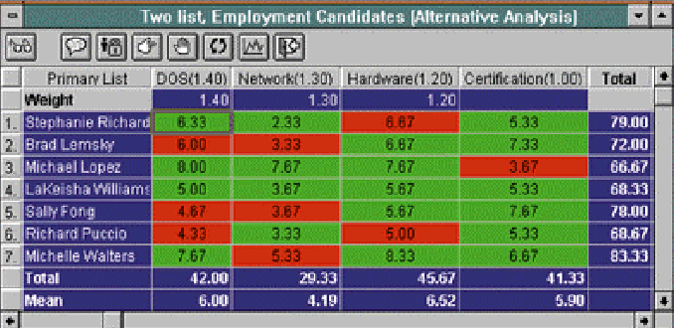
Group Results Matrix

Slide 12
Components of a GDSS and GDSS Software
Database
Model base
Dialogue manager
Communication capability
Special software (also called GroupWare is the hardware and software which supports and augments group work. Groupware applications are not meant to replace people in an interactive situation.)
E.g., Lotus Notes
  people located around the world work on the same project, documents, and files, efficiently and at the same time

Slide 13
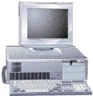

Databases
Model base
GDSS processor
GDSS software
External
databases
Access to the internet
and corporate intranet,
networks, and other
computer system
Dialogue
manager
External database
access
Users

Slide 14
GDSS Alternatives
high
Local area
decision network
Wide area
decision network
Decision frequency
Decision
room
Teleconferencing
low
close
distant
Location of group members

Slide 15
Decision Room
Decision Room
  For decision makers located in the same geographic area or building
  Use of computing devices, special software, networking capabilities, display equipment, and a session leader
  Collect, coordinate, and feed back organized information to help a group make a decision
  Combines face-to-face verbal interaction with technology-aided formalization

Slide 16
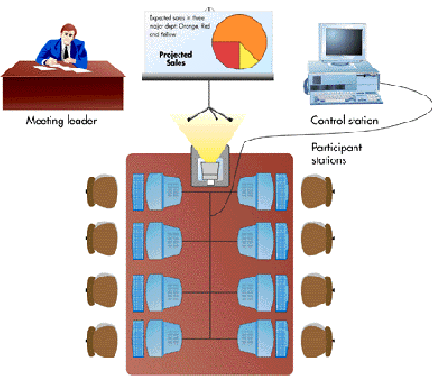

Slide 17
Wide Area Decision Network
Characteristics
  Location of group members is distant
  Decision frequency is high
  Virtual workgroups
    Groups of workers located around the world working on common problems via a GDSS
    Teleconferencing
    where group members across the continents can see each other on the screen, and conduct their meeting as if they were in the same room.

Slide 18
Local Area Decision Network:
A small group whose members are dispersed. When a few group members are unable to meet face-to-face and are dispersed in a limited geographical area, a Local Area Decision Network can be used.
For example, group members may meet in different offices asynchronously using a computerized bulletin board, or they may meet synchronously using a real-time document editor.

Slide 19
Advantages of GDSS
Anonymity –
drive out fear leading to better decisions from a diverse hierarchy of decision makers.
Parallel Communication –
eliminate monopolizing providing increased participation, better decisions.
Automated record keeping –
no need to take notes, they’re automatically recorded.
Ability for virtual meetings –
only need hardware, software and people connected.

Slide 20
Advantages of GDSS
Portability –
Can be set up to be portable… laptop
Global Potential –
People can be connected across the world
No need for a computer guru –
although some basic experience is a must

Slide 21
Disadvantages of GDSS
Cost –
infrastructure costs to provide the hardware and software/room/network connectivity can be very expensive.
Security –
especially true when companies rent the facilities for GDSS; also, the facilitator may be a lower-level employee who may leak information to peers.
Technical Failure –
power loss, loss of connectivity, relies heavily on bandwidth and LAN/WAN infrastructure – properly setup system should minimize this risk

Slide 22
Disadvantages of GDSS
Keyboarding Skills –
reduced participation may result due to frustration.
Training –
learning curve is present for users, varies by situation.
Perception of messages –
lack of verbal communication could lead to misinterpretation.

Slide 23
Typical GDSS Process
1) Group Leader (and Facilitator?) select software, develop agenda
2) Participants meet (in decision room/Internet) and are given a task.
3) Participants generate ideas – brainstorm anonymously
4) Facilitator organize ideas into categories (different for user-driven software)
5) Discussion and prioritization – may involve ranking by some criteria and/or rating to the facilitators scale
6) Repeat Steps 3, 4, 5 as necessary
7) Reach decision
8) Recommend providing feedback on decision and results to all involved

Slide 24
Examples of GDSS
1) “One example of implementation of GDSS is at IBM. They, as well as many other corporations, initiated GDSS to improve group meetings. A specific case involved a plant manager not being able to identify the cause of problems with shop floor control. After having a meeting for two hours with plant personnel all that resulted were arguments and bad feelings.
So after meeting with the company's GDSS facilitator, the manager decided to have ten plant employees, himself, and two junior analysts participate in a GDSS program. They would use electronic brainstorming and voting to resolve the shop floor control problem.
The manager and the facilitator decided the topic would be "What are the key issues in improving shop floor control?"

Slide 25
The manager and the facilitator decided the topic would be "What are the key issues in improving shop floor control?”
After brainstorming for 35 minutes and compiling 645 lines of suggestions, ideas and comments on how to improve shop floor control, the manager found that he had gotten useful information about the issue for the first time.
A list was compiled of the comments and then the members of the group ranked them in order of importance. The results were displayed and a discussion occurred for ten minutes. The manager thanked the participants and was given a printout of all the discussion and results of the group vote.”

Slide 26
2) “Another example is Hewlett-Packard. Their human-factors engineers work at locations all over the world. And they meet in person only once a year. The rest of the time, they have frequent, ongoing meetings to discuss professional and company issues.
But they have these discussions through an electronic conference and final decision making is done with the aid of GDSS .”

